Slide 1
imaGO PHP Project IPD9 – John Abbott College

Slide 2
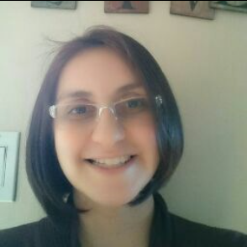
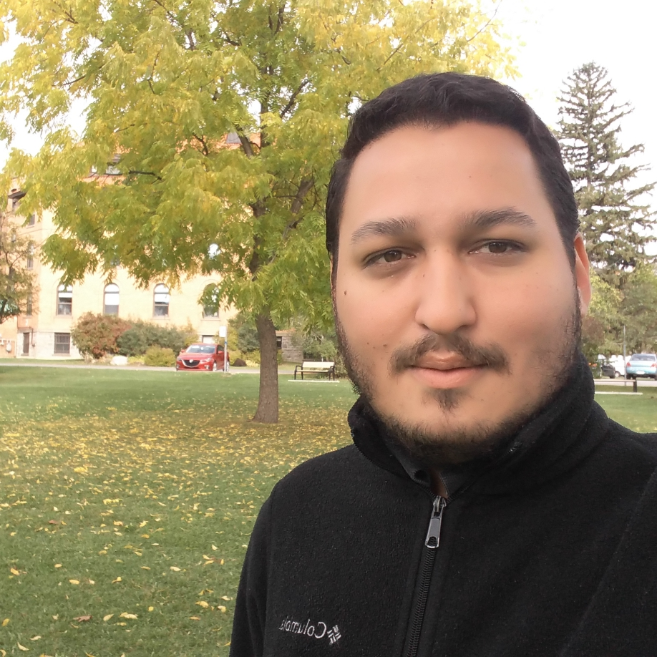
Team
Lorena Gamarra
Nedis Barreto
lorenagamarra@gmail.com
nedisbarreto@gmail.com

Slide 3
Presentation Plan
Challenges & solutions
What we
learned?
Future
work
Background
Overview
Summary

Slide 4
Background
Online photo album
Easy environment to storage your photos online and create albums
Can be used for all devices (computer, smartphone or tablet)

Slide 5
Presentation Plan
Challenges & solutions
What we
learned?
Future
work
Overview
Summary
Background

Slide 6
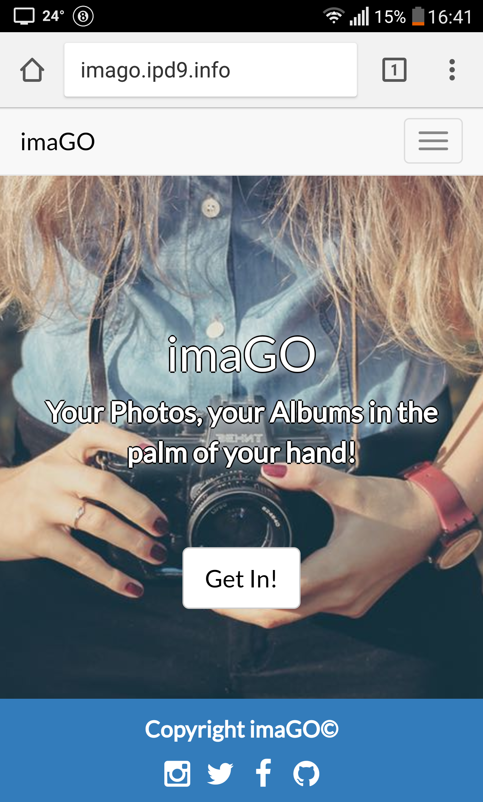
Overview
Responsive website
Basic functions:
Add and delete photos
Create edit and delete albums
Insert/remove photos to/from albums
Online data storage

Slide 7

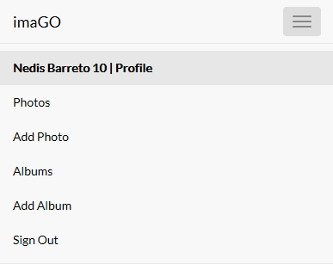
Overview
Intuitive menu

Slide 8
Presentation Plan
Challenges & solutions
What we
learned?
Future
work
Summary
Background
Overview

Slide 9
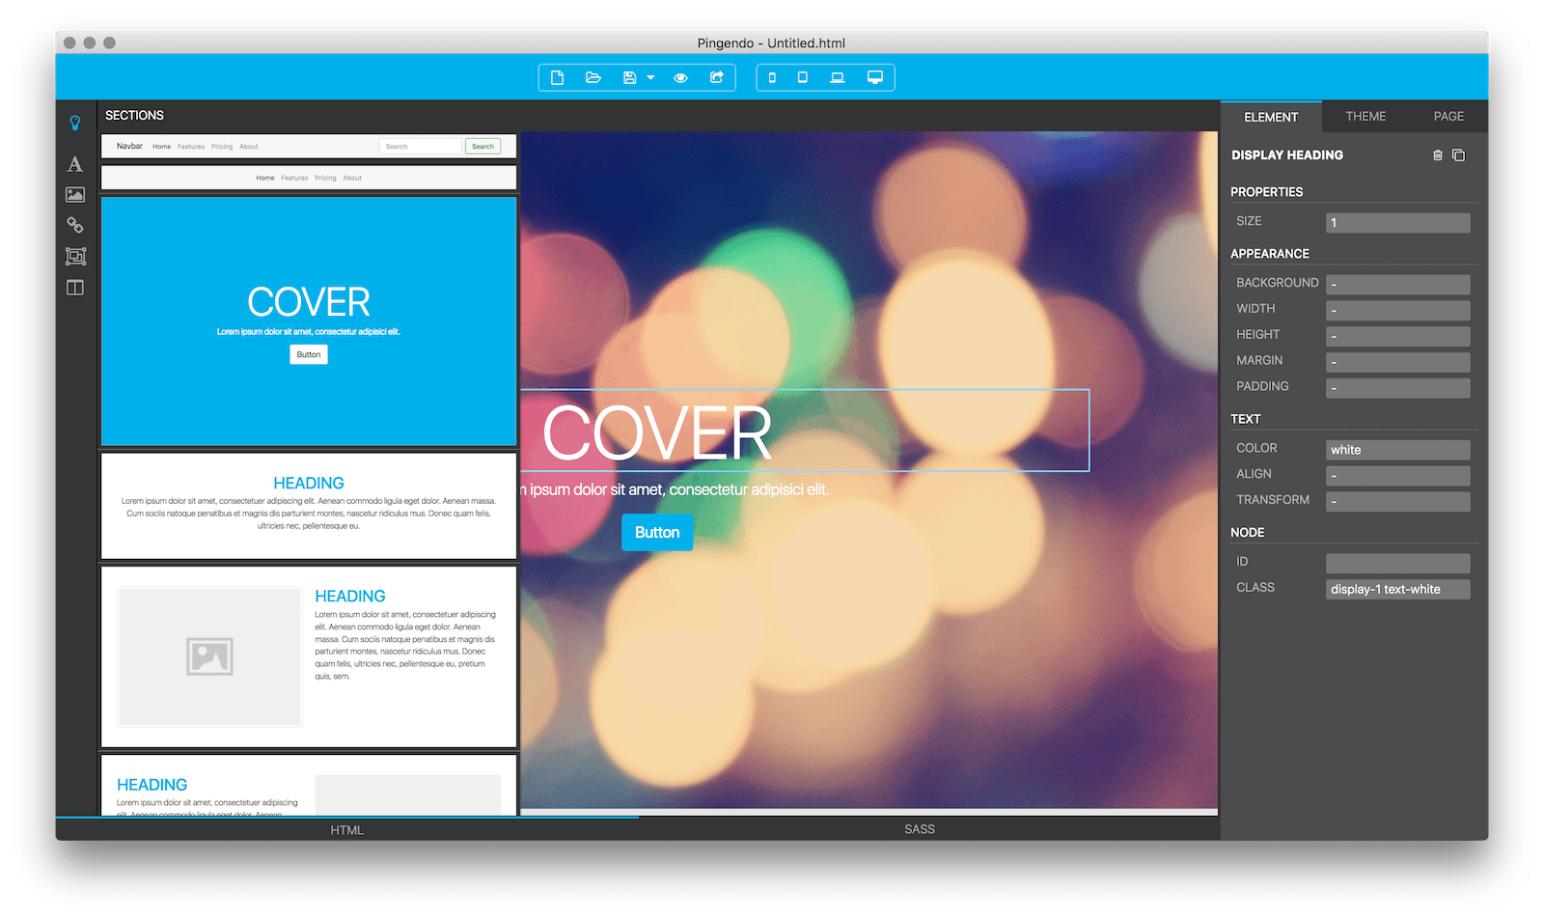
pingendo.com
HTML • Bootstrap
Challenges & Solutions
User interface
Database concept
BLOB images

Slide 10
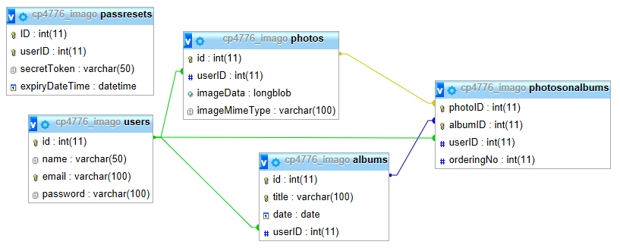
Challenges & Solutions
User interface
Database concept
BLOB images

Slide 11
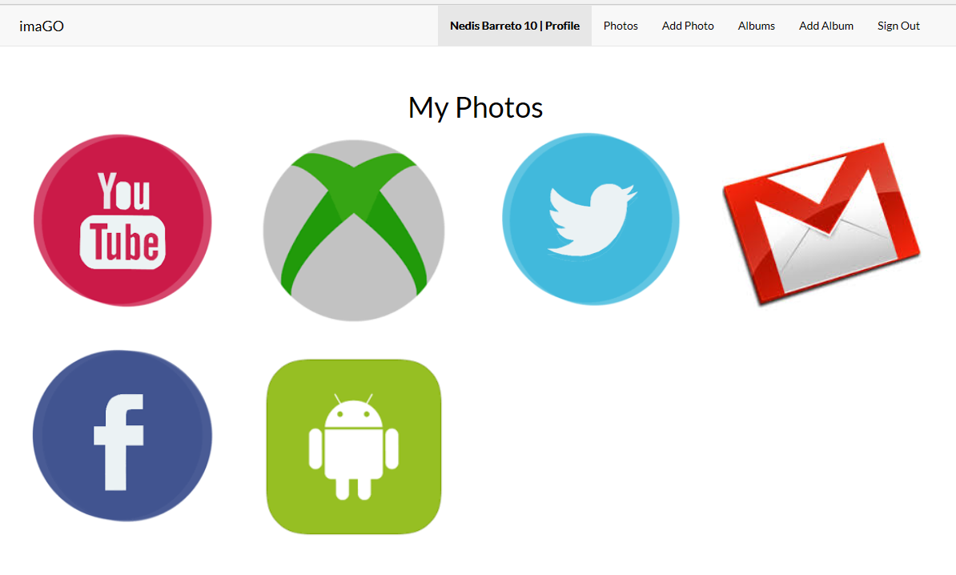
Challenges & Solutions
User interface
Database concept
BLOB images

Slide 12
Presentation Plan
What we
learned?
Future
work
Summary
Background
Overview
Challenges & solutions

Slide 13
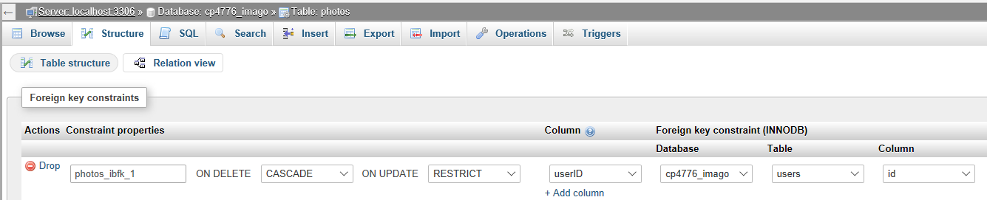
What we learned?
Delete cascade
BLOB images
Delete user even with records
(FK userID on tables photos, albums and photosonalbums)

Slide 14
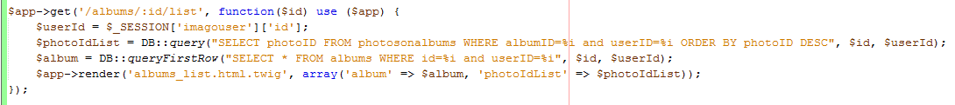
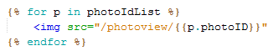
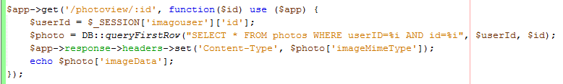
What we learned?
Delete cascade
BLOB images

Slide 15
Presentation Plan
Future
work
Summary
Background
Overview
Challenges & solutions
What we
learned?

Slide 16
Future work
Show a photo as album cover
Sort photos within album
Share album (read-only, login not required)
Facebook Login

Slide 17
Presentation Plan
Summary
Background
Overview
Challenges & solutions
What we
learned?
Future
work

Slide 18
Summary
Registration, Login, Logout
Edit and delete profile
Request email to reset password
Add and delete photo
Add, edit and delete album
Insert and remove photo into album

Slide 19
Presentation Plan
Background
Overview
Challenges & solutions
What we
learned?
Future
work
Summary

Slide 20
Thanks!
Any questions?

Slide 21
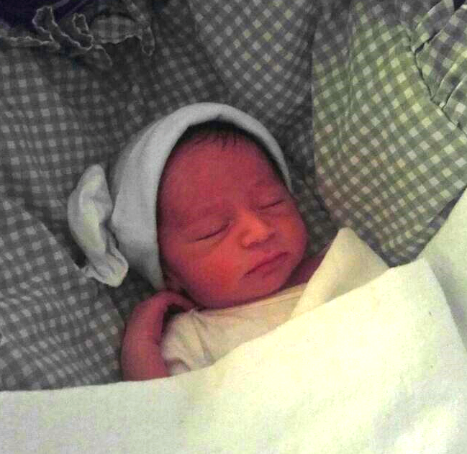
👶
ERIC

